Slide 1
Intro to Computer Hardware
MAHEK RAJESH AHUJA

Slide 2
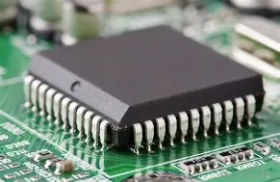
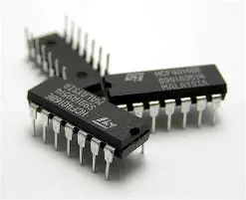
Integrated Circuit (IC)
An Integrated Circuit (IC) is a tiny chip made of semiconductor material (usually silicon) that contains thousands to millions of electronic components such as transistors, resistors, and capacitors. These components are integrated into a single unit to perform specific electronic functions.
ICs are used in nearly all electronic devices,because they are compact, reliable, energy-efficient, and cost-effective.
Types of Integrated Circuits:
Analog ICs
Work with continuous signals (e.g., audio, voltage).
Examples: Amplifiers, oscillators.
Digital ICs
Work with discrete signals (0s and 1s).
Examples: Microprocessors, memory chips, logic gates.
Mixed-Signal ICs
Combine analog and digital functions in one chip.
Examples: Analog-to-digital converters (ADC), digital-to-analog converters (DAC).

Slide 3
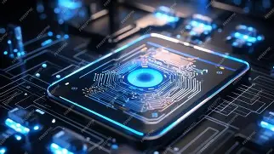
MOTHERBOARD
Introduction to Motherboard
The motherboard is the main circuit board of a computer. It acts as the central hub that connects and allows communication between all the components of the system — including the CPU, RAM, storage devices, graphics card, and peripheral devices.
It provides slots, ports, and connectors for both internal and external hardware and ensures that data flows smoothly between them.
Key Functions of a Motherboard:
Houses the CPU (processor)
Holds RAM modules
Connects storage devices (HDD/SSD)
Enables communication between all components
Includes USB, HDMI, audio, and network ports

Slide 4
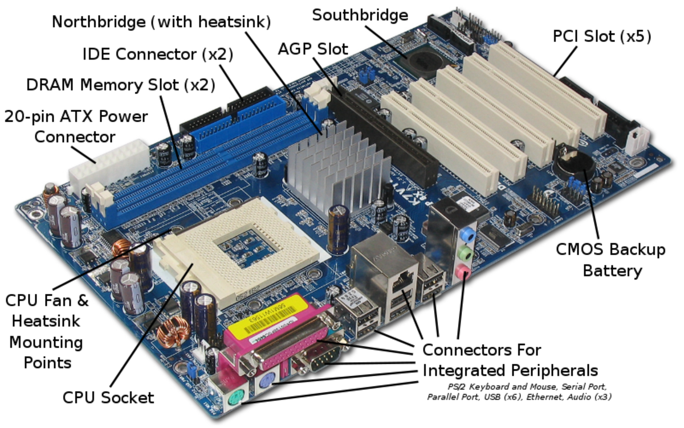
Main Components Found on a Motherboard:
CPU socket
RAM slots
Chipset
Power connectors
Expansion slots (PCIe)
BIOS/UEFI chip
Input/Output (I/O) ports

Slide 5
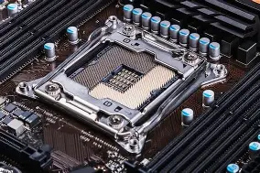
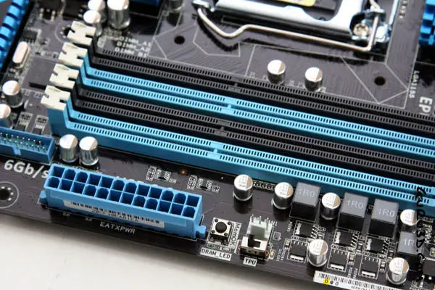
1. CPU Socket
Holds the Central Processing Unit (CPU).
Allows the processor to communicate with other parts of the computer.
2. RAM Slots
These are long slots where RAM (Random Access Memory) modules are installed.
RAM temporarily stores data for quick access by the CPU during operations.
Northbridge: Handles high-speed communication with the CPU, RAM, and graphics.
Southbridge: Manages input/output functions like USB, audio, and storage.

Slide 6
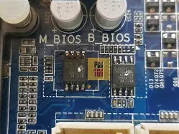
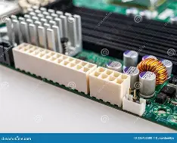
4. BIOS/UEFI Chip
BIOS stands for Basic Input Output System.
UEFI stands for Unified Extensible Firmware Interface.
Stores the firmware that starts the computer and controls hardware settings.
Allows you to configure settings like boot order and system time.
5. Power Connectors 24 pins
Connect to the Power Supply Unit (PSU).
Distribute electrical power to the motherboard and all connected components.
6. Expansion Slots
Include PCI (Peripheral Component Interconnect) and PCIe (PCI Express) slots.
Used to install additional cards like graphics cards, sound cards, network cards, etc.

Slide 7
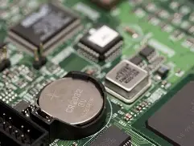
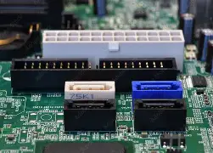
7. CMOS Battery
CMOS stands for Complementary Metal-Oxide Semiconductor.
Powers the BIOS memory when the computer is turned off.
Maintains system time, date, and basic configuration.
8. SATA Ports
SATA stands for Serial Advanced Technology Attachment.
Used to connect storage devices like HDDs (Hard Disk Drives), SSDs (Solid State Drives), and optical drives.
9. M.2 / NVMe Slots
High-speed slots for modern SSDs.
Used for faster and compact storage devices compared to traditional SATA drives.
battery ensures your computer remembers its configuration and keeps accurate time even when unplugged.

Slide 8
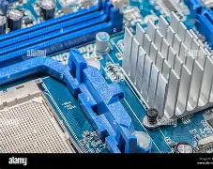
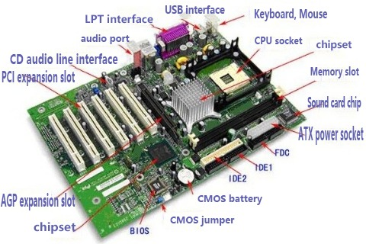
Heatsinks
Metal components that absorb and dissipate heat from chipsets and VRMs.
Help in maintaining optimal temperature.

Slide 9
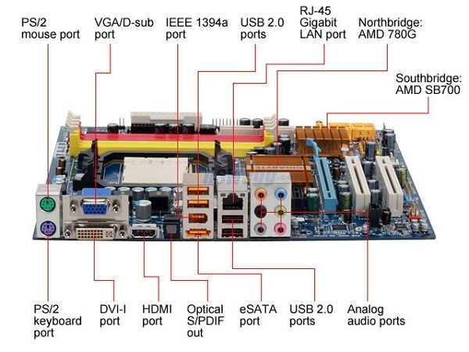
I/O (Input/Output) Ports on the Back Panel
1. USB Ports (Universal Serial Bus)
Used to connect peripherals like keyboard, mouse, printer, USB drives, etc.
2. HDMI Port (High-Definition Multimedia Interface)
Transmits both high-quality video and audio signals to monitors and TVs.
3. VGA and DVI Ports
Older ports used for connecting monitors.
VGA is analog; DVI is digital.

Slide 10
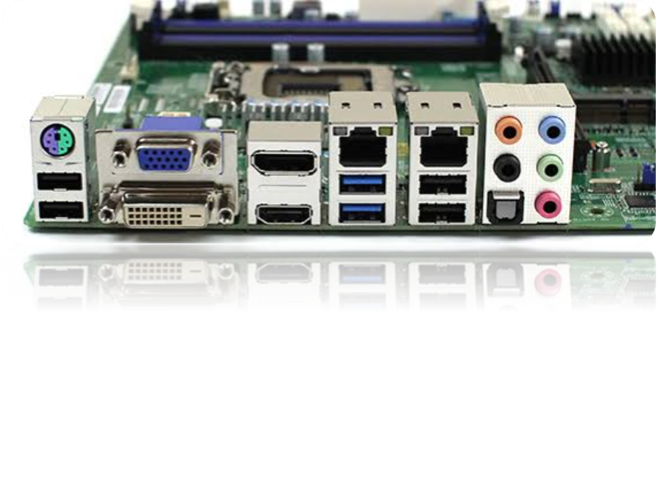
4. Audio Jacks
Connects microphones, speakers, and headphones.
5. Ethernet Port (RJ-45)
Used for wired internet and network connections.
6. PS/2 Ports
Older ports for connecting keyboard and mouse (now mostly replaced by USB).
7. DisplayPort
A modern video port, similar to HDMI but supports higher resolutions and refresh rates.
8. USB-C / Thunderbolt Ports
Modern high-speed ports used for data transfer, charging, and video output

Slide 11
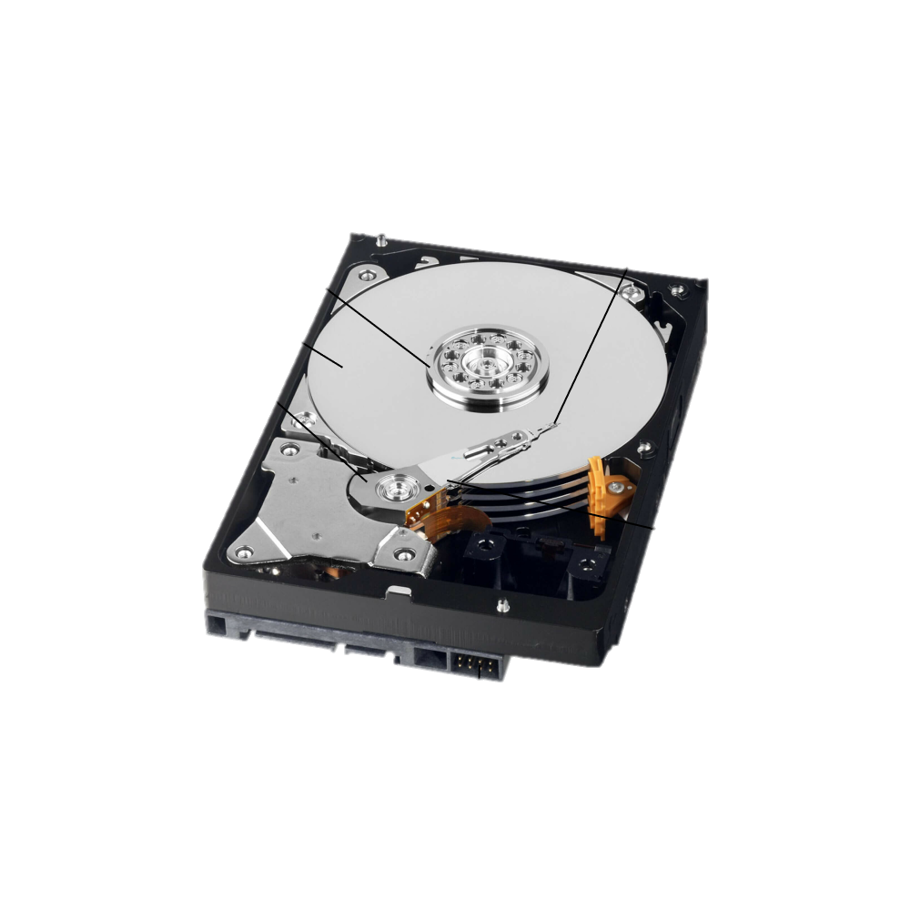
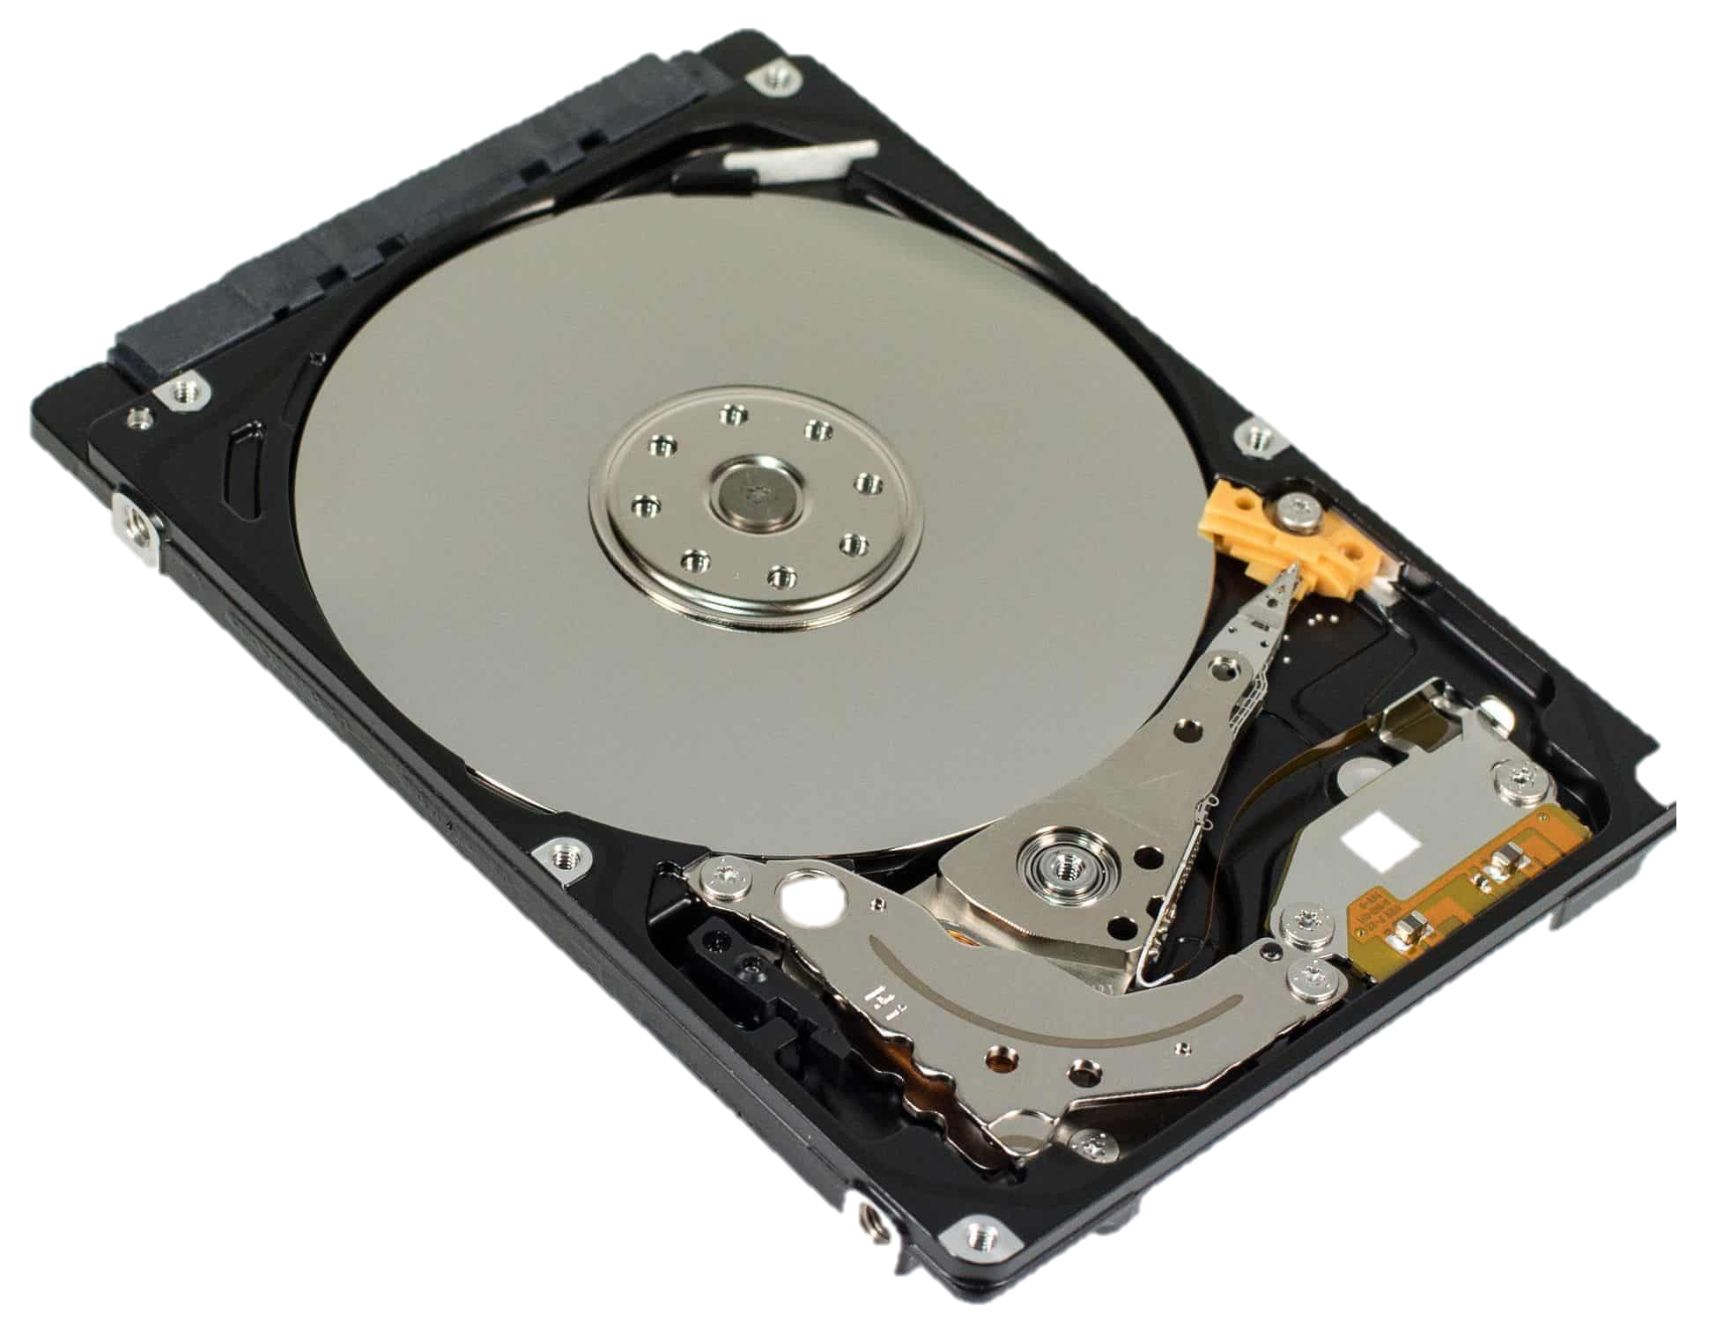
HARD DRIVE
Introduction to Hard Drive
A Hard Drive, also known as a Hard Disk Drive (HDD), is a data storage device used in computers to store and retrieve digital information.
It is a non-volatile storage device, which means it retains data even when the computer is turned off.
The hard drive stores everything — from the operating system, software, and applications, to personal files like documents, photos, videos, and music.
Made up of spinning magnetic disks (called platters) and a read/write head.
Data is read and written using magnetic signals.
Comes in different storage sizes (e.g., 500 GB, 1 TB, 2 TB, etc.).
Typically slower than modern Solid State Drives (SSDs), but still widely used for large storage capacity at lower cost.

Slide 12
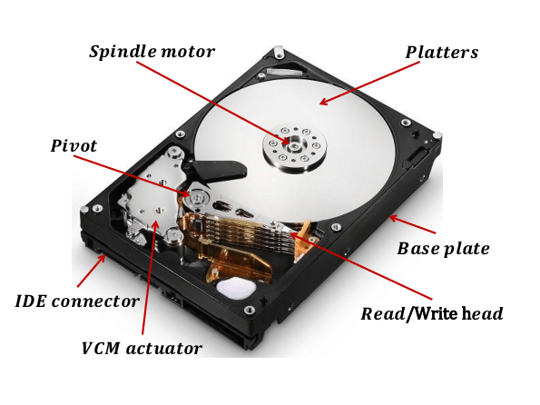
Main Parts of a Hard Disk
1. Platter
The circular disk where data is stored magnetically.
Made of glass or aluminum and coated with a magnetic material.
A hard drive may contain multiple platters stacked together.
Each platter has two surfaces for data storage.
2. Spindle
The central shaft that holds and spins the platters.
Spins at high speeds (e.g., 5400 RPM, 7200 RPM, or more).
Faster spin = faster data read/write speeds.
3. Read/Write Head
A tiny component that reads data from and writes data to the platter.
Each surface of a platter has its own head.
The heads float just above the platter surface while it spins.
4. Actuator Arm
Holds the read/write heads and moves them across the platters to access different data tracks.
Works like the arm of a record player, controlled precisely by the actuator motor.

Slide 13
Pin Type | Total Pins | Name | Function | Connects To
SATA Data | 7 | Data Interface | Transfers digital data | Motherboard (SATA Data Port)
 |  | Pin 1 – GND | Ground
 |  | Pin 2 – A+ (Tx+) | Transmit Data (Positive)
 |  | Pin 3 – A– (Tx–) | Transmit Data (Negative)
 |  | Pin 4 – GND | Ground
 |  | Pin 5 – B– (Rx–) | Receive Data (Negative)
 |  | Pin 6 – B+ (Rx+) | Receive Data (Positive)
 |  | Pin 7 – GND | Ground
SATA Power | 15 | Power Connector | Provides electric power | Power Supply (SATA Power Cable)
 |  | Pin 1-3 – +3.3V | Power supply (not always used)
 |  | Pin 4-6 – Ground | Common ground
 |  | Pin 7-9 – +5V | Primary voltage for most drives
 |  | Pin 10-12 – Ground | Common ground
 |  | Pin 13-15 – +12V | Power for motors/spinning platters

Slide 14
Feature | HDD (Hard Disk Drive) | SSD (Solid State Drive)
Technology | Spinning magnetic disks (platters) | No moving parts, uses flash memory
Speed | Slower (more time to read/write data) | Much faster (quick boot & file access)
Durability | Prone to damage (moving parts) | More durable (no moving parts)
Noise | Can be noisy due to spinning disks | Completely silent
Power Usage | Uses more power | Uses less power
Storage Capacity | Higher (up to several TBs at lower cost) | Lower (but increasing), costlier per GB
Cost | Cheaper | More expensive
Common Use | Bulk storage in desktops, budget laptops | High-speed needs: gaming, editing, boot drives

Slide 15
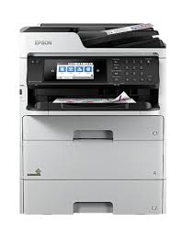
Multifunctional Devices (MFDs)
Devices that perform multiple functions like input, output, processing in a single unit.
Device | Functions
Printer-Scanner-Copier (All-in-One) | Prints, scans, copies (input + output)
Touchscreen Monitor | Input (touch) + Output (display)
Fax Machines | Scans, sends, and receives documents
POS Terminals (Billing Systems) | Inputs via barcode + prints receipt
Importance:
Saves space, cost, and power
Increases efficiency in homes and offices
Reduces number of separate devices needed

Slide 16
A document by
~ Mahek Rajesh Ahuja

Slide 17
Title and Content Layout with List
Add your first bullet point here
Add your second bullet point here
Add your third bullet point here

Slide 18
Title and Content Layout with Chart

Slide 19
Two Content Layout with Table
First bullet point here
Second bullet point here
Third bullet point here
Class | Group 1 | Group 2
Class 1 | 82 | 95
Class 2 | 76 | 88
Class 3 | 84 | 90

Slide 20
Title and Content Layout with SmartArt
Step 1 Title
Step 2 Title
Task description
Task description
Task description
Task description
Task description
Task description
Task description
Step 3 Title
Task description
Task description
Step 4 Title
Task description
Task description

Slide 21
Add a Slide Title - 1

Slide 22
Add a Slide Title - 2

Slide 23
Add a Slide Title - 3

Slide 25
Add a Slide Title - 4

Slide 26
Add a Slide Title - 5

